Slide 1
Sales Forecast for StarTech
Storyboarding
19th September 2019

Slide 2

| Agenda
Approach to the Problem
Executive Summary
SGQ
Findings and Recommendations
Sales forecast for year 2018
Appendix

Slide 3
A systematic data driven approach was followed to forecast sales
Recommendations
Insights were studied in detail and recommendations were drawn from them
Hypothesis Analysis
Hypotheses were analyzed based on the available data and the end questions
Forecasting
Exploring the Problem
ARIMA model was used to forecast sales
Problem statement was studied in detail and gap was identified
Exploratory Data Analysis
Data was cleaned and filtered for analysis
EDA was performed to obtain findings

Slide 4
| Agenda
Approach to the Problem
Executive Summary
SGQ
Findings and Recommendations
Sales forecast for year 2018
Appendix

Slide 5
Executive Summary
Recommendations:
Revenue generated in fourth quarter was greater than the other three quarters
Insights:
Vacuum cleaner products generated the most revenue and TV products generated least revenue
Promotions during Martin Luther King Day followed by Presidents day in the first quarter are generating lower sales compared to the other promotions in the year.
Key Findings:
Executive Summary
Although repeat customers are less in number, they contribute significantly to the overall sales
Martin Luther King Day followed by Presidents day promotion should be revised to generate more sales in first quarter
Improvement of promotional campaigns need to be done for The Mellow Store to improve the sales of that store
Provide loyalty programs to convert new customers to repeat customer
It has been observed that the spike of sales in November is caused by holidays such as Thanksgiving, Black Friday and Veterans day
Highest revenue generated during promotion was from the Nodding Jester Store and the least was generated from the Mellow store
Promotional offers should be revised for the TV products over all the quarters

Slide 6
| Agenda
Approach to the Problem
Executive Summary
SGQ
Findings and Recommendations
Sales forecast for year 2018
Appendix

Slide 7
The team needs to identify the factors that lead to ineffective marketing campaign, to increase the sales
The team needs to identify the factors that influence the marketing campaign and determine its impact on sales
StarTech is a grocery and general merchandise retailer and its Marketing & Campaigning team is responsible for creating, running and maintaining advertisements
It was observed that the company's marketing campaigns were ineffective, which resulted in a dip in sales
The different factors of the marketing campaign that caused the dip in sales and the sales forecast for the revised marketing campaign need to be determined
Outcome: Increase in visibility based on the revised marketing campaign leading to a larger customer base and an increase in sales
Behavior: The marketing campaigns are revised and maintained based on the factors provided by the team
Insights: The team identifies the factors that lead to an ineffective marketing campaign and estimates how it will affect future sales
What are the factors that influence the marketing campaign?
What is the impact of these factors on sales?

Slide 8
The four key attributes which affect the sales during marketing campaign were identified
KEY FACTORS
Advertisements affect the effectiveness of marketing campaign
External factors affect the effectiveness of the marketing campaign
Customer related factors affect the effectiveness of the marketing campaign
Store related factors affect the effectiveness of marketing campaign

Slide 9
| Agenda
Approach to the Problem
Executive Summary
SGQ
Findings and Recommendations
Sales forecast for year 2018
Appendix

Slide 10
Bivariate analysis was performed on the two hypotheses that had appropriate data
Hypothesis | Analysis | Insights
Repeat customers are more receptive to promotional offers which leads to an increase in sales | Bivariate analysis of the type of customer and sales | Repeat customers contribute equally to sales during promotion and non-promotion period
Customers tend to buy more products during festive occasion, which leads to an increase in sales | Bivariate analysis between sales from festive and sales from non-festive season | Promotions during festive day generate more sales compared to non festive promotion

Slide 11
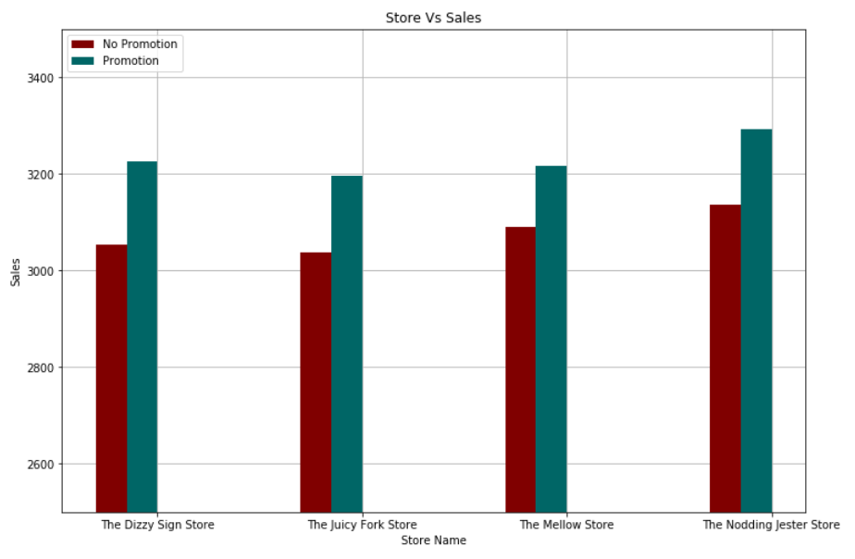
Promotional periods contribute to higher sales and the least increase in sales was observed for Mellow store
Per day sales in each store during a promotion and non promotion period
Findings:
Per day sales are higher when there is a promotion
Sales (in $)
STORE NAME | DIFFERENCE IN SALES
JUICY FORK | 5.23%
DIZZY STORE | 5.66%
MELLOW STORE | 4.11%
NODDING STORE | 4.95%
Recommendations:
Improvement of promotional campaigns for The Mellow Store to improve the overall sales

Slide 12
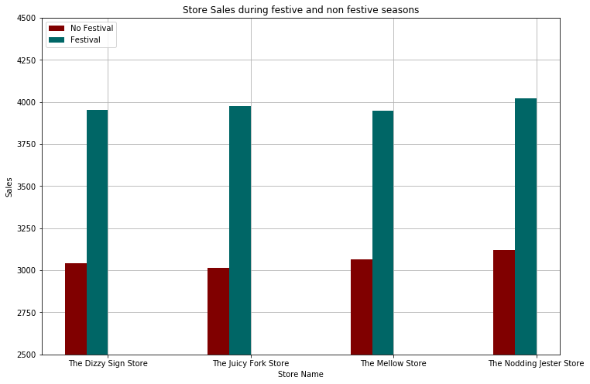
Promotions during festive day generate more sales compared to non festive promotion
Per day sales in each store during a festival and non festival promotion
Findings:
A minimum of 31% increase in sales were observed
Sales (in $)
STORE NAME | DIFFERENCE IN SALES
JUICY FORK | 37%
DIZZY STORE | 35%
MELLOW STORE | 34%
NODDING STORE | 31%
Deep Dive:
There is a need to identify those non-festive promotions that contribute the least to sales
*Festival days: Independence day, Thanksgiving day, Christmas day

Slide 13
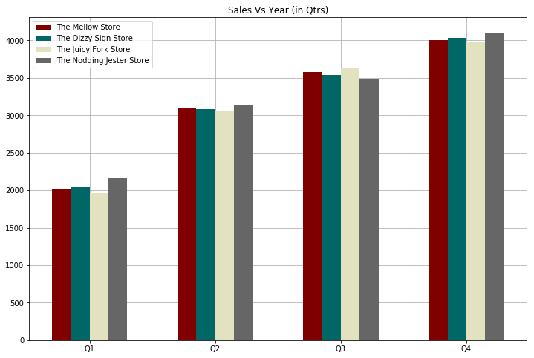
Q4 generates the most sales and Q1 generates the least sales in each store during the promotion period
Sales generated by different stores in each quarter
Findings:
Q4 generate more sales in promotion period.
Most sales generated is from Nodding jester in Q4.
Q1 promotions generates the least sales
Sales (in $)
Deep Dive:
There is a need to identify the promotions that contribute the least to sales in Q1
Quarter

Slide 14
Veterans day and Thanksgiving day generate higher per day sales compared to the rest
Findings:
More per day sales were generated during Veterans day promotion
The least per day sales were generated during Martin Luther King promotion
Recommendation:
Upselling products during Martin Luther King day and Presidents day promotion will increase the overall sales

Slide 15
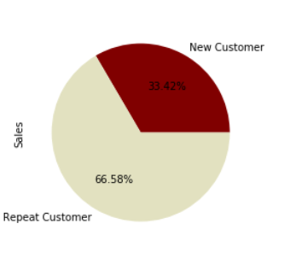
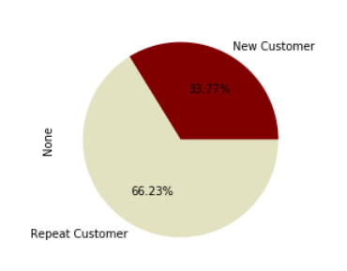
Repeat customers contribute equally to sales during promotion and non-promotion period
The Mellow Store
Findings:
Repeat customers contribute equally to sales during promotion or non-promotion period
Although 74% of the total customers are new customers, the overall sales contribution from repeat customers is 66%(approx.)
33.42%
33.77%
Recommendation:
Provide loyalty programs to convert new customers to repeat customer
During Promotion period
During Non Promotion period
*The comparisons for the rest of the stores are in appendix

Slide 16
| Agenda
Approach to the Problem
Executive Summary
SGQ
Findings and Recommendations
Sales forecast for year 2018
Appendix

Slide 17
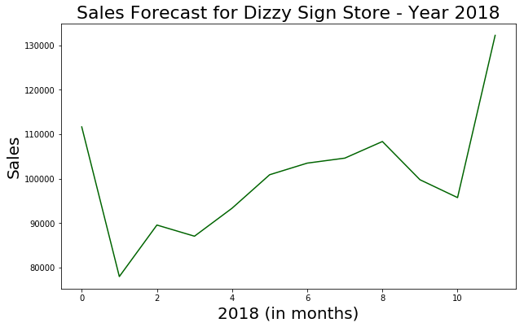
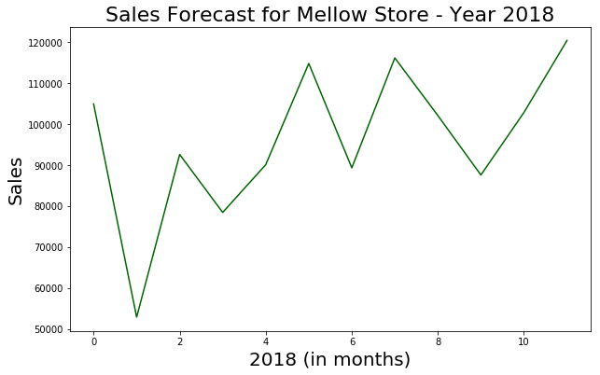
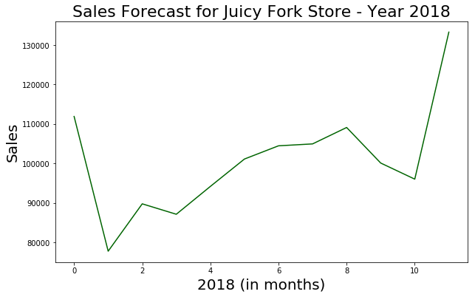
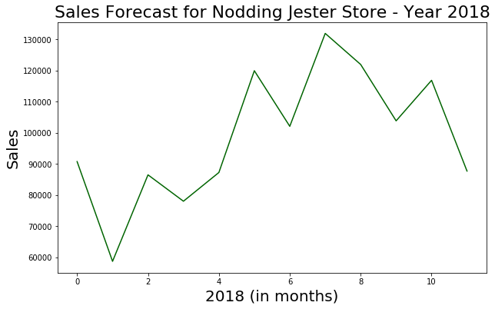
Forecasting sales for fiscal year 2018 by studying the data from 2011 to 2017
Sales growth : 5.88%
MAPE = 28.05%
Sales growth : 0.90%
MAPE = 28.35%
Sales growth : -1.31%
MAPE = 28.01%
Sales Growth : 4.59%
MAPE = 28.35%

Slide 18
Upon increasing the effectiveness of promotion by a factor of 10%, there will be a hike of 5.03% in overall sales
RECOMMENDATION | PROMOTIONS | FACTOR | OVERALL INCREASE IN SALES (PERCENTAGE) | GAIN IN SALES
Provide loyalty programs to convert new customers to repeat customer |  | 10% increase in number of loyal customers | 3.2% | $11,454
Martin Luther King Day followed by Presidents day promotion should be revised to generate more sales in first quarter | Martin Luther King Jr Day Presidents Day | 10% increase in sales | 0.59% 0.61% | $2130 $4426
 |  | Total | 1.21% | $18,010
The sales forecast if current trends are followed is $357,955 .
If all the recommendations suggested are incorporated the sales will increase to $375,965

Slide 19

THANK YOU

Slide 20
| Agenda
Approach to the Problem
Executive Summary
SGQ
Findings and Recommendations
Sales forecast for year 2018
Appendix

Slide 21
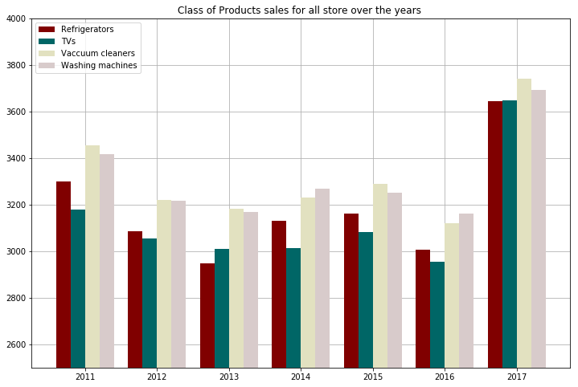
Highest per day sale during sales campaign for product were recorded in 2017

Slide 22
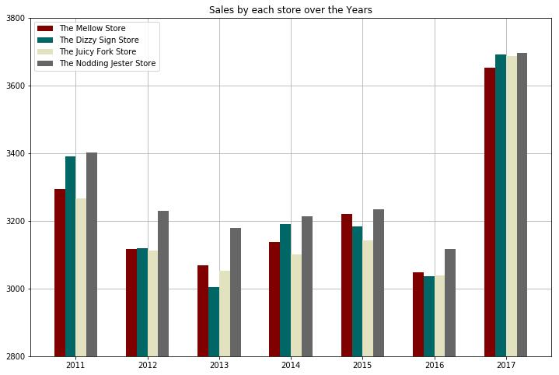
2017 witnessed the most sales per day during sales campaign across all the stores

Slide 23
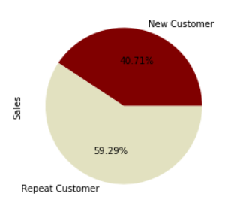
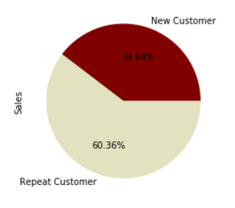
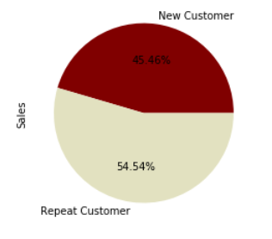
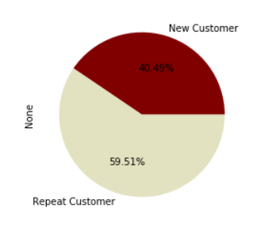
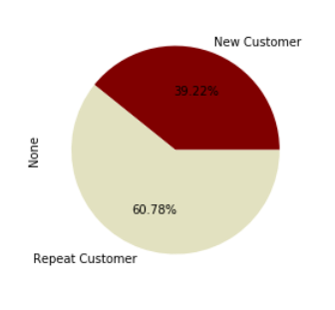
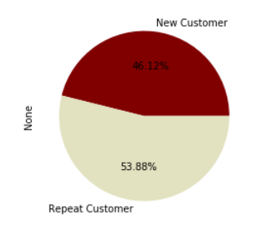
Repeat customers contribute equally to sales during promotion or non-promotion period
The Dizzy Sign Store
The Juicy Fork Store
The Nodding Jester Store
During promotion period
During non promotion period

Slide 24
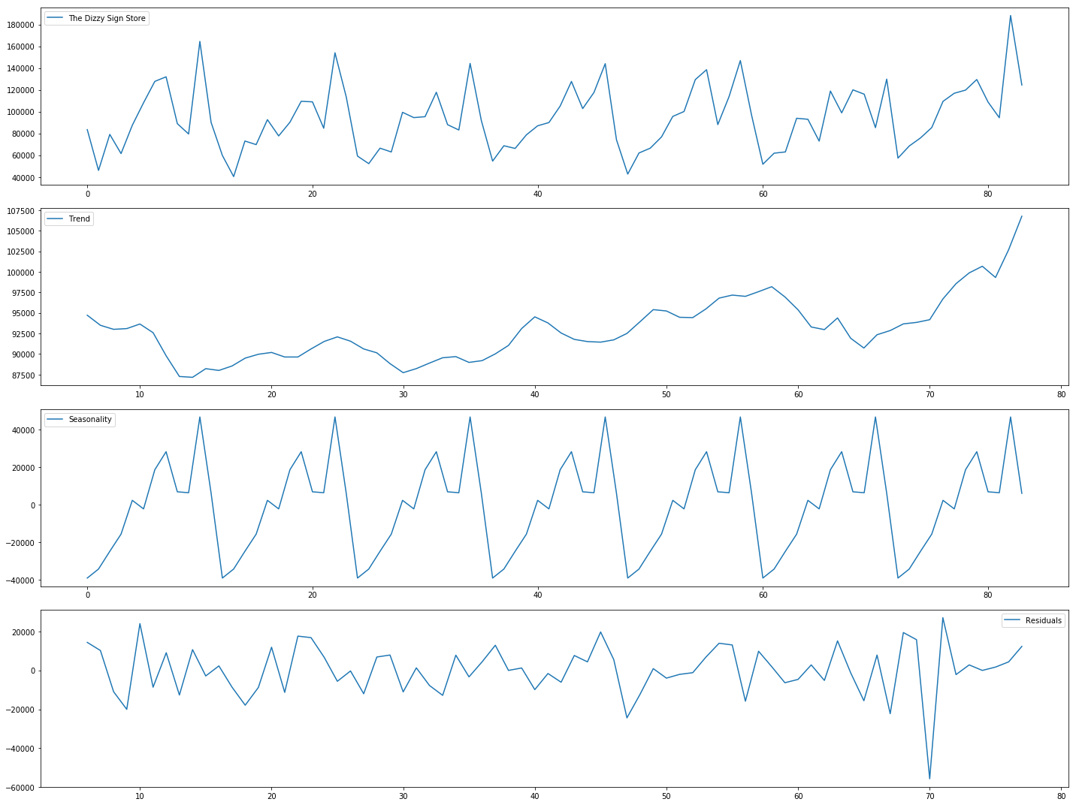
Classical Decomposition of Time Series was performed to observe the different components of time series
Time-series of sales amount for all the 84 months for the Dizzy Sign store.
Decomposition of sales time-series in to trend, seasonality and residuals with frequency – 12.

